Slide 1



Building a Crossword Puzzle game
PROJECT MEMBERS
JEEVASRUTHI S
KOUSIKAA SHREE S
KRITHIKA S
JAIHARI D (19ITR028)

Slide 2

•Use a 2D array or matrix to represent the crossword puzzle grid.
•Implement a tree or prefix tree data structure to store and search for words efficiently.
•Utilize backtracking algorithms to find valid word placements in the grid.
•Implement constraint satisfaction techniques to ensure word intersections and grid validity.
•Use heuristics or scoring functions to guide the search process and optimize solutions.
•Integrate randomization algorithms for puzzle generation and variation.
•Implement data structures like stacks or queues for undo/redo functionality.
•Provide a user interface for displaying the puzzle, entering words, and interacting with game features.
•Handle input validation, error checking, and scoring mechanisms for gameplay

Slide 3
Objectives
Grid Creation & Word Placement: Design a grid system to accommodate word entries, ensuring proper alignment and intersections of words.
Efficient Word Search: Implement a structure or algorithm to efficiently store, search, and validate words during gameplay.
Puzzle Generation & Difficulty: Develop a system to generate puzzles with varying levels of difficulty by utilizing randomization and heuristic techniques.
User Interface & Interaction: Build an intuitive user interface that allows players to input words, check answers, and receive feedback, while supporting features like hints, scoring, and undo/redo actions.
3

Slide 4
Data structures , Algorithms and AWT used
Data Structures:
Use a 2D array for the crossword grid.
Store words and clues in Lists or HashMaps for fast access and manipulation.
Algorithms:
Implement a backtracking algorithm to generate crossword puzzles dynamically.
Use search algorithms like DFS or BFS to help with hinting systems.
Create validation algorithms to check if the user’s input matches the correct answer.
AWT:
Use AWT components like Frame, TextField, Label, and Button to create the UI.
GridLayout can be used to structure the crossword grid, and ActionListeners can handle user input and interactions
4

Slide 5
Modules and Functions used
Java AWT (java.awt)AWT (Abstract Window Toolkit) provides the tools needed for building the graphical components of the crossword puzzle, such as the grid, buttons, labels, and panels.
AWT Event (java.awt.event)AWT Event is used to handle user interactions like clicking on a grid cell or entering a word. It includes classes such as ActionListener, MouseListener, and KeyListener.
Java ArrayList (java.util.ArrayList)ArrayList is used to dynamically store and manage the list of words to be placed in the crossword puzzle. It allows easy addition, removal, and retrieval of words.
java.io.Serializable for Saving and Loading Puzzle StatesThe Serializable interface allows you to save the crossword puzzle's current state (grid, words, etc.) to a file and reload it later.
javax.swing.JOptionPane for DialogsThis class is used to display pop-up messages, confirm actions, and capture user input.
5

Slide 6
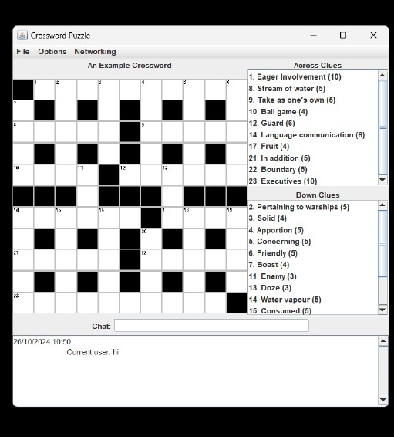
OUTPUT

Slide 7
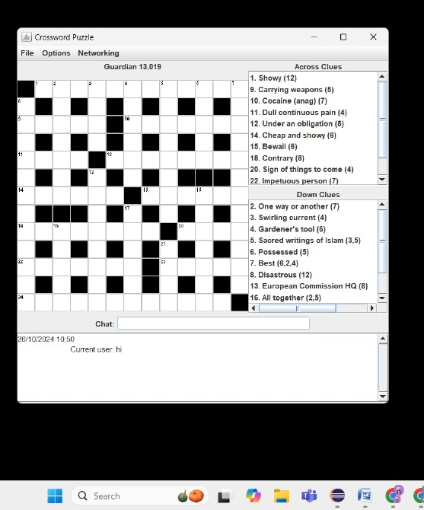

Slide 8
Software Tools used
Eclipse IDE : An integrated development environment used for writing, debugging, and managing Java projects.
Java Runtime Environment (JRE) : Necessary for running Java applications on the user's machine.
Notepad : For quick edits or documentation outside of the IDE.
File System : Used to store project files, images, and serialized task data

Slide 9
Thank you!

